Slide 1

Computer
Networking
New Technical College Campus

Slide 2
About Modern Technical College Campus
The new branch of the technical college is designed as a modern, technology-driven campus that supports academic learning, administration, and advanced computing needs. The campus consists of four main buildings.
This technical college branch is a fully integrated academic environment that combines:
Administrative efficiency
Practical engineering education
Advanced computing and research
Rich learning resources

Slide 3
Network Design Goals
GOALS
Secure communication between buildings
High-speed access for labs
High availability and reliability
Easy management and monitoring
Scalability for future growth

Slide 4


Modern Technical College Campus buildings
01
02
03
04
Administration
Engineering
Computer Science
Library
administrative offices, handling student records, finance, human resources, and overall campus operations.
Provides classrooms, workshops, and laboratories for hands-on training and practical education in various engineering disciplines.
Serves as the technology hub with advanced computer labs and facilities for programming, software development, AI, and cybersecurity studies.
Acts as a learning and research center offering books, digital resources, study spaces, and access to academic databases.

Slide 5
Administration Building
Purpose
Technical Requirements
This building serves as the operational and management center of the college.
Office computers for staff
Secure access to student information systems
Internal servers (or access to centralized data center)
High availability and secure networking
Printers, scanners, and document management systems
Key Functions
Networking Needs
Student registration and records
Finance and payroll
Human resources
Academic coordination
IT and network control offices
Secure wired LAN for staff
Limited guest Wi-Fi for students
Strong access control and data protection

Slide 6
Engineering Building
Purpose
Facilities
This building supports hands-on engineering education and applied technical training.
Lecture halls
Engineering laboratories
Workshops (e.g., circuits, robotics, materials)
Faculty offices
Departments Typically Included
Technical Requirements
Electrical Engineering
Mechanical Engineering
Civil Engineering
Electronics and Communication
High-power electrical supply for equipment
Wired network connections for lab machines
Lab management software
Safety and access control systems

Slide 7
Computer Science Building
Purpose
Specialized Computer Labs
This is the core technology hub of the campus.
High-performance PCs or workstations
Virtualization and cloud platforms
Isolated lab networks for cybersecurity training
Central servers for code repositories and databases
Departments and Programs
Computer Science
Software Engineering
Artificial Intelligence
Data Science
Cybersecurity
Networking Needs
Very high bandwidth
Wired Ethernet for labs
Secure segmentation (VLANs)
Controlled internet access for experiments

Slide 8
Library Building
Purpose
Technical Requirements
The library acts as a knowledge and research center.
Public computers for students
Strong Wi-Fi coverage
Content filtering and access control
Quiet and low-noise infrastructure
Facilities
Digital Services
Reading areas
Group study rooms
Digital library stations
Quiet zones
Printing and scanning services
Online academic databases
E-books and journals
Learning management system access
Research software tools

Slide 9
Campus Buildings & Users
Library Building
Computer Science Building
3 Labs × 25 PCs = 75 PCs
Engineering Building
25%
3 Labs × 25 PCs = 75 PCs
3 Labs × 25 PCs = 75 PCs
25%
25%
Total PCs FOR 3 studding buildings = 225

Slide 10
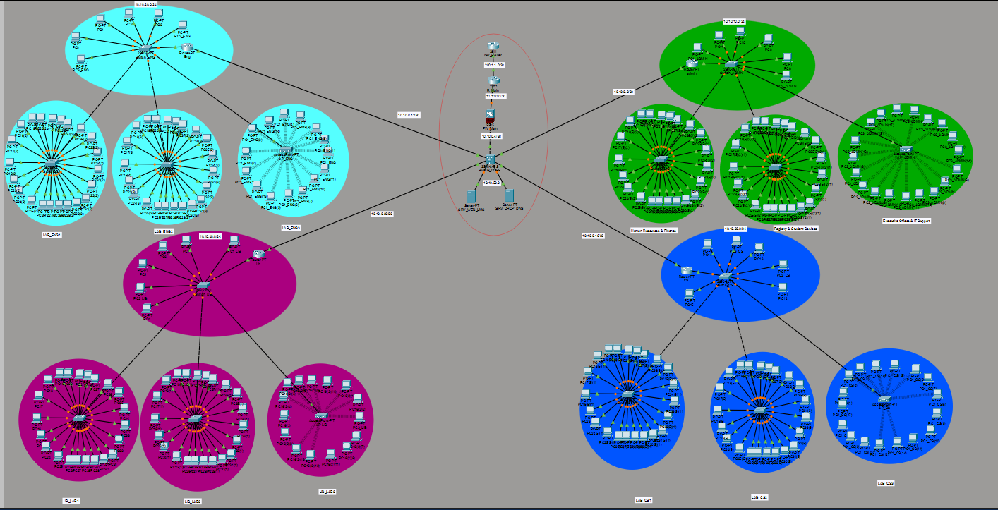
Network Topology design
Engineering
Library
Administration
Computer Science

Slide 11
Users / Devices per Building
Category | PCS | Wireless APs
Administration Building | 75 | 6
Engineering Building | 75 | 4
Computer Science Building | 75 | 6
Library | 75 | 4
PCS NUMBER
300

Slide 12
Building LAN Subnets
VLAN subnet |  | Assets | Usable Range
10 | 10.10.10.0/24 | 255.255.255.0 | 10.10.10.1 – 10.10.10.254
20 | 10.10.20.0/24 | 255.255.255.0 | 10.10.20.1 – 10.10.20.254
30 | 10.10.30.0/24 | 255.255.255.0 | 10.10.30.1 – 10.10.30.254
40 | 10.10.40.0/24 | 255.255.255.0 | 10.10.40.1 – 10.10.40.254
50 | 10.10.50.0/24 | 255.255.255.0 | 10.10.50.1 – 10.10.50.254
60 | 10.10.60.0/24 | 255.255.255.0 | 10.10.60.1 – 10.10.60.254

Slide 13
Main Topology
Centralized control improves performance and management.
Star topology is used within each building.
Network Topology
All buildings connect to a central core network.
Fiber optic cables connect buildings.

Slide 14
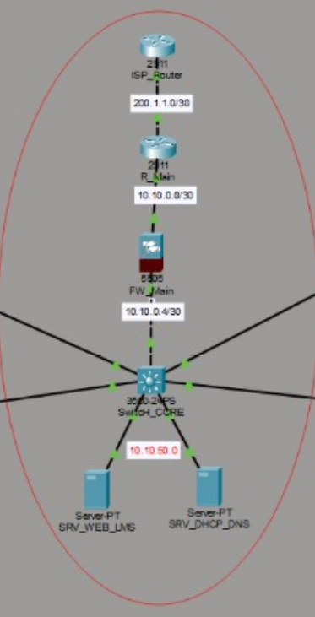
High-Level Topology
Core (Administration Data Room):
​
  2× Layer-3 Core Switches (redundant)​
  Firewall at the edge + ISP Router​
  Wireless Controller + Servers
Distribution/Access (each building):​
  Access switches (PoE) for PCs + APs

Slide 15
High-Level Topology
Inter-building links:
Fiber trunk links from Admin (core) to each building (star topology)​
Packet Tracer diagram should show​
ISP ↔ Router ↔ Firewall ↔ Core L3 Switches​
Core ↔ (fiber trunks) ↔ building access switches​ VLANs on each building switch, trunk uplinks, APs mapped to SSIDs/VLANs

Slide 16
Internet Access
Priority given to academic and lab traffic.
Bandwidth management for fair usage.
What are we working on
Guest access is limited.

Slide 17
Different IP ranges for each building.
Improves security and network management.
IP Addressing & VLANs
Reduces broadcast traffic.
VLANs separate traffic between departments.

Slide 18
VLAN | NAME | WHO
10 | ADMIN-STAFF | admin offices PCs
20 | ADMIN-SERVERS | servers/data center
30 | ENG-FACULTY | engineering staff
40 | ENG-LABS | engineering lab PCs
50 | CS-FACULTY | CS staff
60 | CS-LABS | CS lab PCs
70 | LIB-STAFF | library employees
80 | LIB-PUBLIC | library public PCs
90 | STUDENT-WIFI | authenticated students
100 | GUEST-WIFI | internet only
200 | MGMT | device management

Slide 19
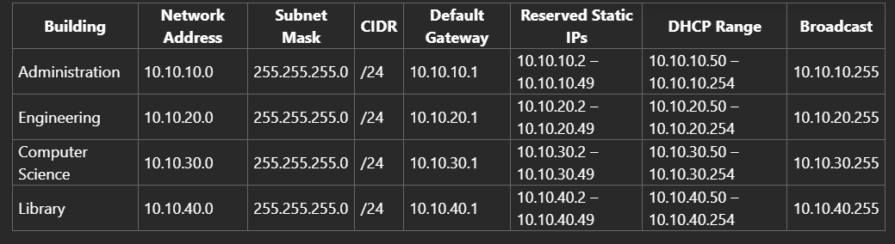
Building LAN Subnets

Slide 20
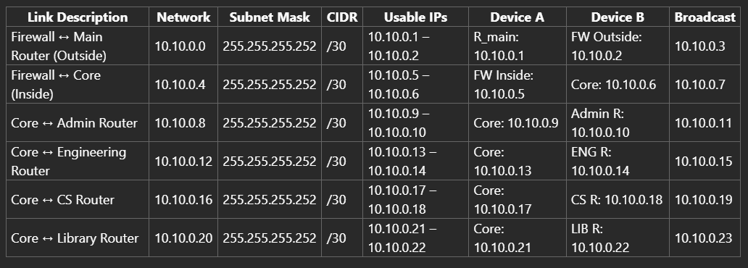
Infrastructure & Point-to-Point Links (/30)

Slide 21
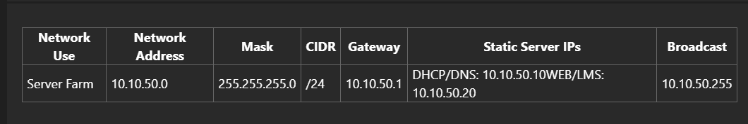
Server Network Subnet

Slide 22
Network Devices Used
Routers
Firewalls
01
04
for internet connectivity.
Firewalls for security.
switches
02
JCore and access switches for internal networking.
Servers
05
Wireless access points
Servers for data and applications.
03
Wireless access points for Wi-Fi coverage.

Slide 23
Cost Calculation with Device Models (EGP)
Category | Device Type | Model (Real-World Example) | Quantity | Total Cost (EGP)
Network Devices | Core Layer-3 Switch | Cisco Catalyst 3560-24PS | 1
 | Access Switches | Cisco Catalyst 2960-24TT-L | 4
 | Building Routers | Cisco ISR 4331 | 4
 | Main Router (R_main) | Cisco ISR 4331 | 1
 | ISP Router | Cisco 2911 ISR | 1
 | Firewall | Cisco ASA 5506-X | 1
 | Wireless Access Points | Cisco Aironet 1832i | 4
 | Servers | Dell PowerEdge R350 | 2 | 1,108,200
PCs (300) | Desktop PCs | HP 200 G4 All-in-One | 300 | 6,600,000
Cabling | Ethernet Cable | CAT6 (305m box) | 3
 | Patch Cords & RJ-45 | Standard CAT6 accessories | — | 26,200
TOTAL PROJECT COST |  |  |  | 7,734,400 EGP

Slide 24
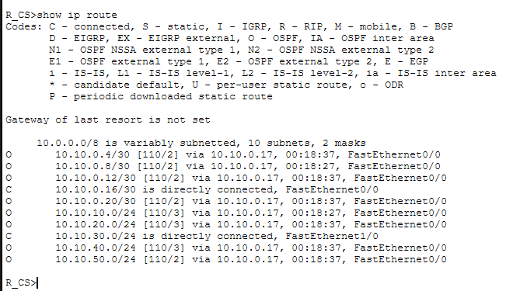
IP routing
Routing implementation is complete and verified.

Slide 25
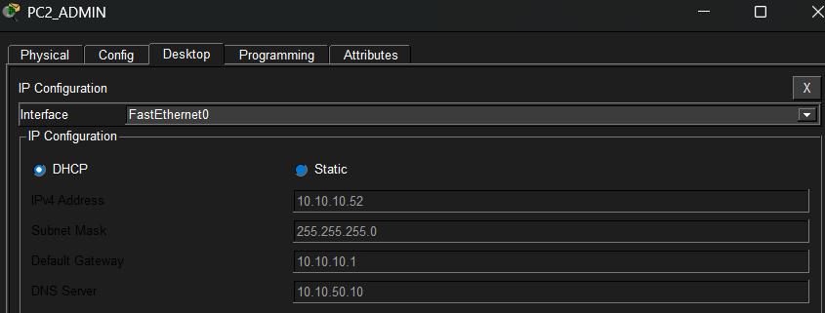
DHCP
Routing implementation is complete and verified.

Slide 26
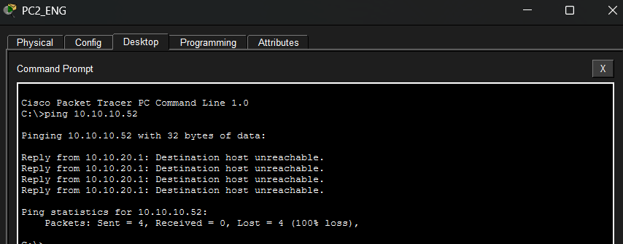
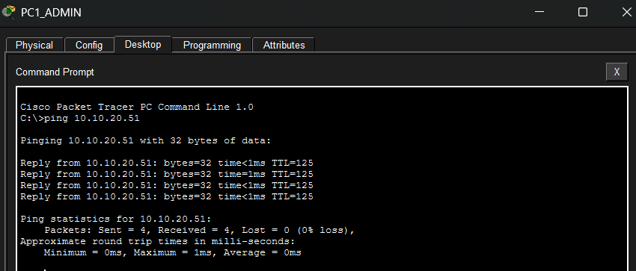
ACL
The implementation of the ACL was successful, achieving the goal of restricting access for the Engineering department while maintaining connectivity for the Administration department.

Slide 27
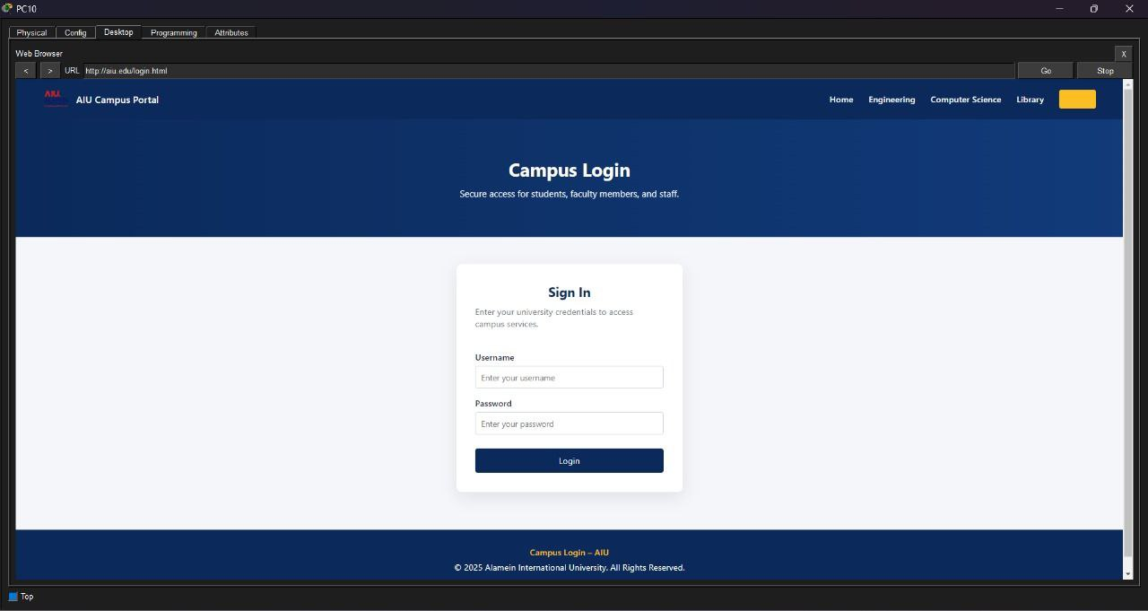
Campus Login

Slide 28
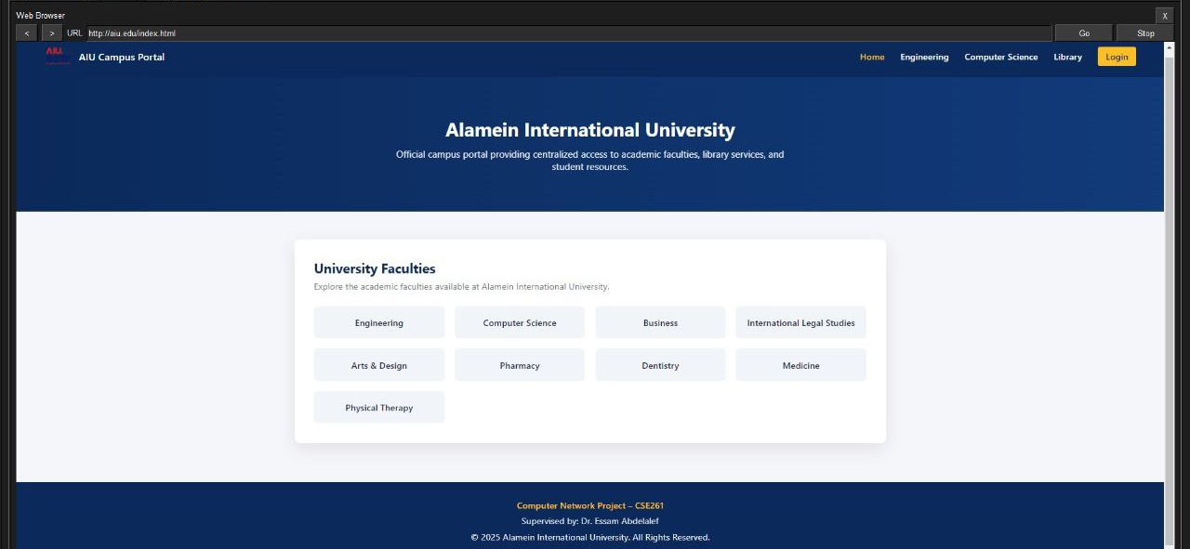
Faculty selection

Slide 29
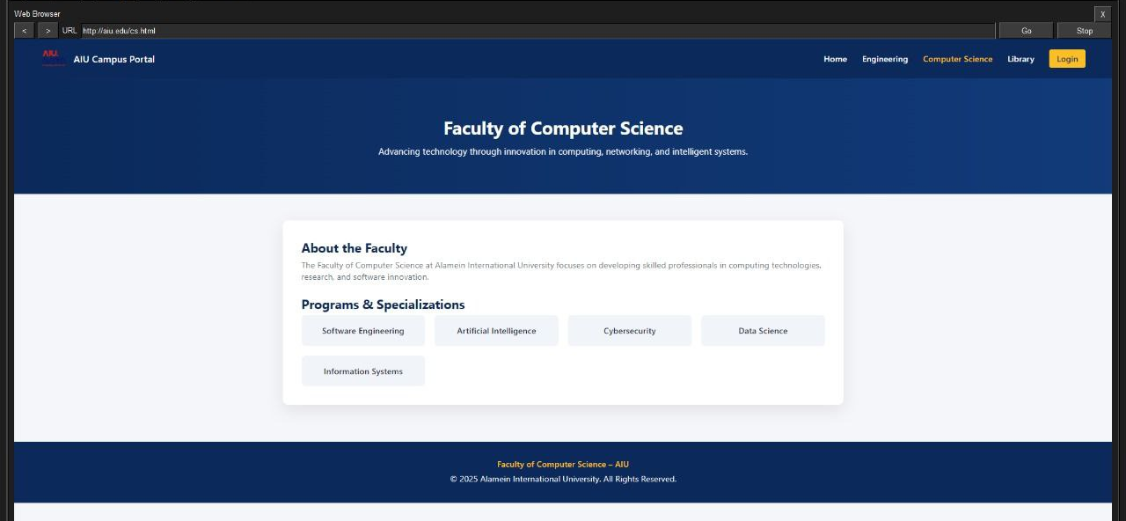
Computer science Program

Slide 30
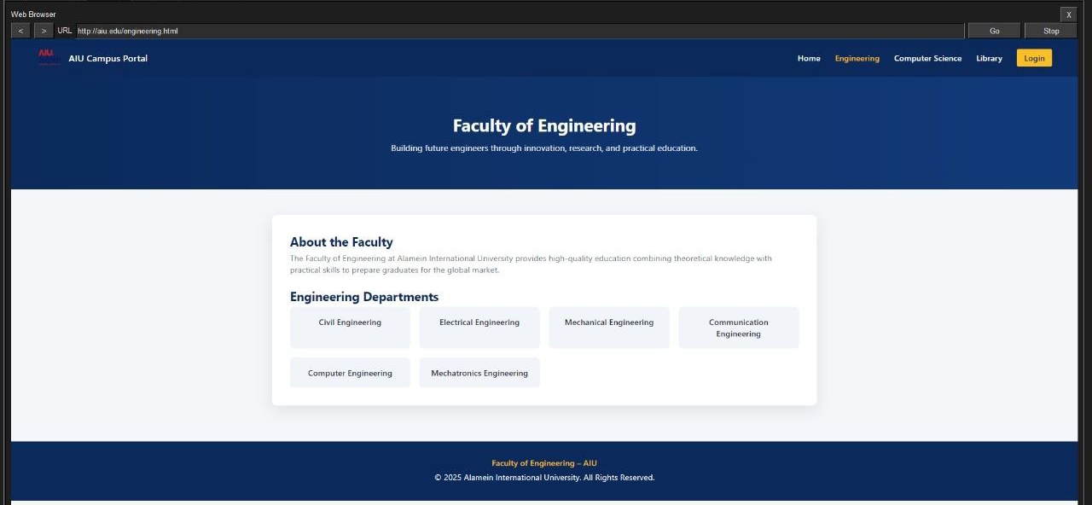
Engineering Departments

Slide 31
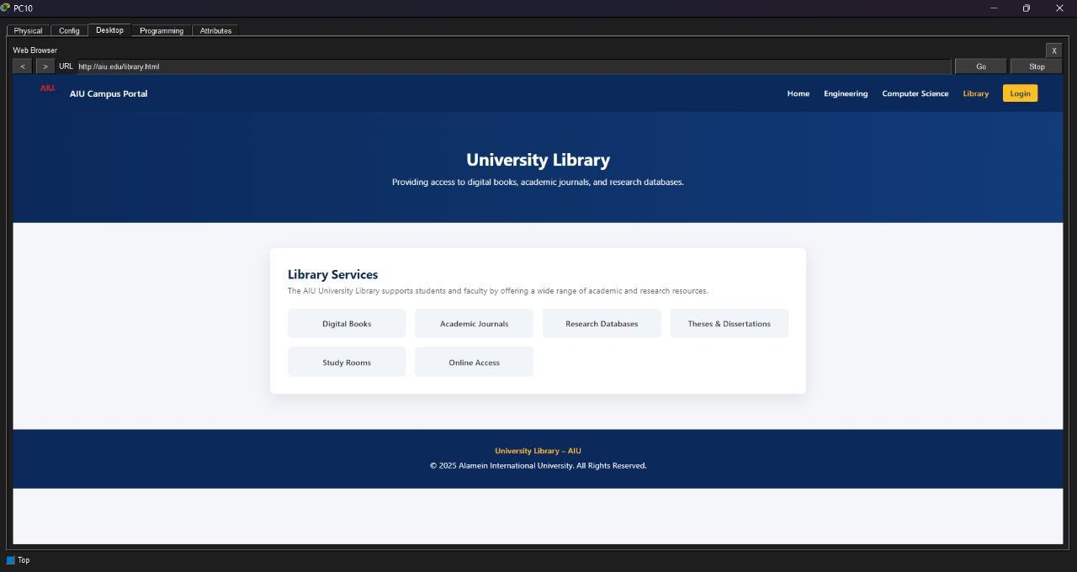
Library Services
The website demonstrates how the network supports real services used in a university, such as portals and information systems, and validates DNS and server functionality.

Slide 32
Conclusion
Strong separation using VLANs + ACLs (Admin protected, Guest isolated)
Easy scalability (/24 per department, OSPF routing-ready)
Centralized services in Admin (servers + controller) with fiber backbone to buildings

Slide 33
Team members
Adel sobhy
23101780
Yassin Ali Attia
23101505
Youssef Moharm
23101517
Mostafa Waleed
23101602
Ali hassan
23101422
Abdelrahman hamed
23101420
Kerolos nader
23101441
Veronica Kamil
23100810

Slide 34
ANY QUESTIONS ?
THANK YOU
super visor doc / Essam Abdellatif

